Slide 1
Name: Form:
SCIENCE FUNDAMENTAL KNOWLEDGE QUIZ BOOKLET
Key Stage 4
Paper 1
Physics

Slide 2
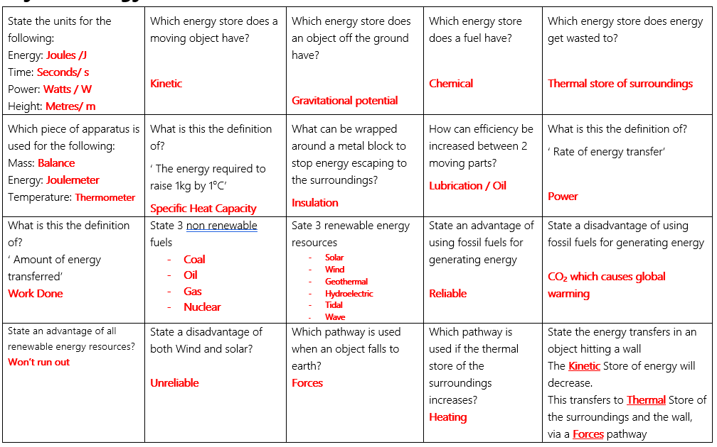
P1– Energy

Slide 3
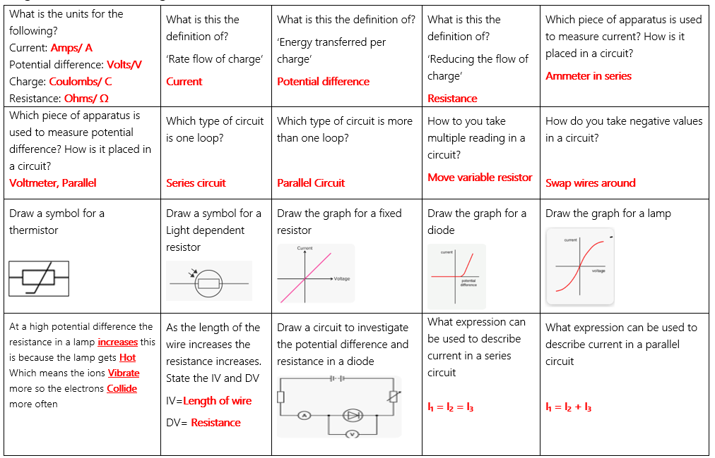
P2– Electricity circuits

Slide 4
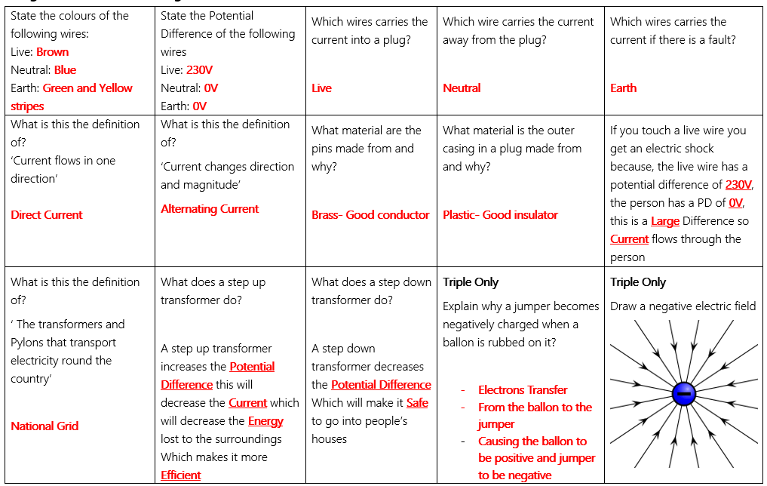
P2– Electricity in the home

Slide 5
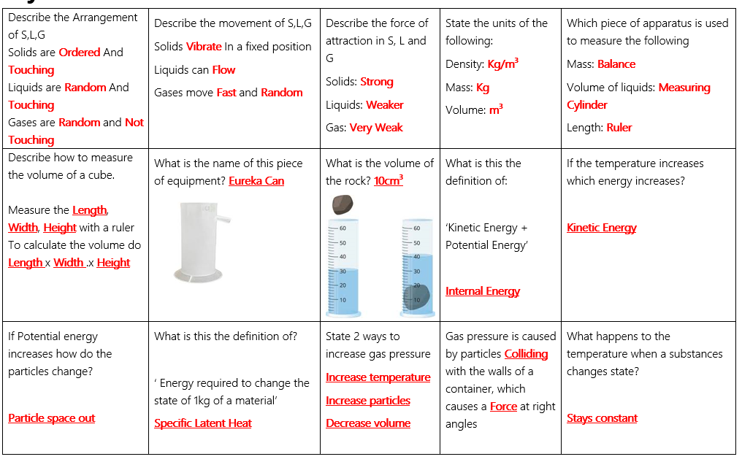
P3– Particles

Slide 6
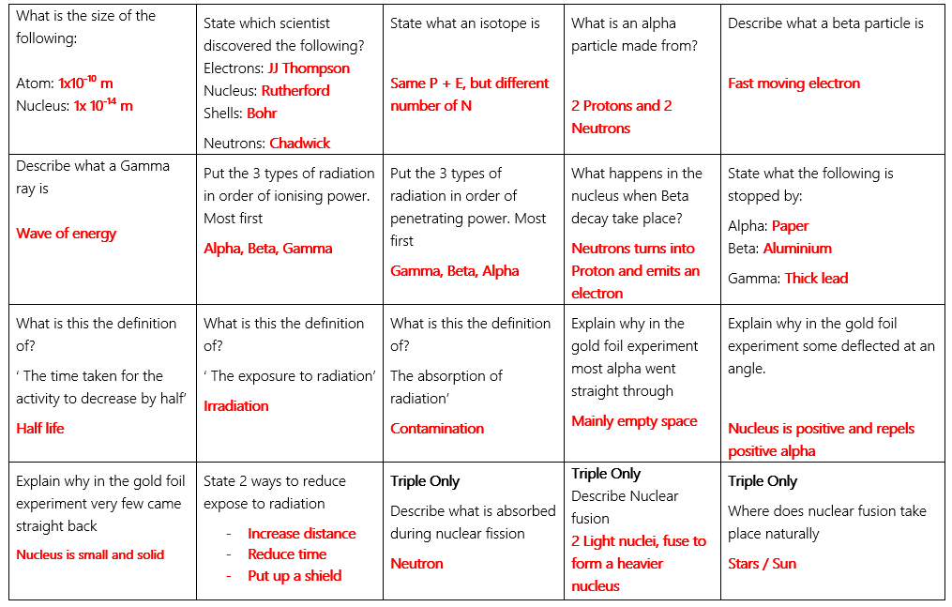
P4– Atomic structure

